Slide 1




RAJEEV INSTITUTE OF TECHNOLOGY, HASSAN.
DEPARTMENT OF COMPUTER SCIENCE AND ENGINEERING
COMPUTER GRAPHICS AND IMAGE PROCESSING MINI PROJECT
“SAILING OF SHIP DURING DAY AND NIGHT”
UNDER THE GUIDANCE OF,
Mr. SANJAY M
DEPT. OF CSE
RIT , HASSAN
SUBMITTED BY,
MEGHANA SHREE J(4RA21CS041)

Slide 2

TABLE OF CONTENTS
1. Abstract
2. Introduction
3. Problem statement
4. Objectives
5. System Requirement Specifications
6. Conclusion

Slide 3
ABSTRACT
In this project, we propose Moving ship of day and night is a mini project and implemented using graphics package. Our project is used to demonstrate the moving of ship through day and night. In this project user can change background from morning, afternoon to night and it even has shoot mode. It moves forward, backward. This graphical implementation can be visualized better with the help of C language an OpenGL library.
INTRODUCTION
Interactive graphics applications are essential for various fields, from educational tools to complex simulations. Drawing basic geometric shapes is one of the first steps in learning computer graphics, providing a foundation for more advanced topics. This project focuses on creating an interactive OpenGL application where users can draw circles, squares, and rectangles with customizable dimensions. The application leverages OpenGL's capabilities to handle rendering and user input efficiently, demonstrating the practical aspects of graphics programming.
ABSTRACTIn this project, we propose Moving ship of day and night is a mini project and implemented using graphics package. Our project is used to demonstrate the moving of ship through day and night. In this project user can change background from morning, afternoon to night and it even has shoot mode. It moves forward, backward. This graphical implementation can be visualized better with the help of C language an OpenGL library.

Slide 4
Problem Statement
The goal is to create a visually realistic simulation of a ship sailing both during the day and night. This requires accurate modeling of the ship, its environment, and the dynamic effects of weather and time of day.
Daytime
Nighttime
Dynamic Environment
The ship should appear realistic under daylight conditions, with accurate lighting and shadows, as well as reflections on the water.
At night, the ship's lights should be visible and cast realistic shadows on the water, while the sky should accurately represent the night sky.
The simulation should include realistic weather effects, such as wind, rain, and waves, dynamically affecting the ship's movement and appearance.

Slide 5


Objectives
This simulation aims to create a visually impressive and engaging experience for users. It seeks to capture the beauty and challenges of sailing with a focus on realistic details.
1
Realistic Ship Model
The ship's design and movement should be accurate, with attention to detail in its rigging, sails, and hull.
2
Dynamic Environment
The simulation should include a dynamic environment with realistic weather effects, including wind, rain, and waves.
3
Day and Night Cycle
The simulation should accurately depict the change from day to night, with realistic lighting effects and celestial bodies.
4
Immersive Experience
The simulation should provide an immersive experience, allowing users to feel like they are on the ship, experiencing the sights and sounds of the sea.

Slide 6

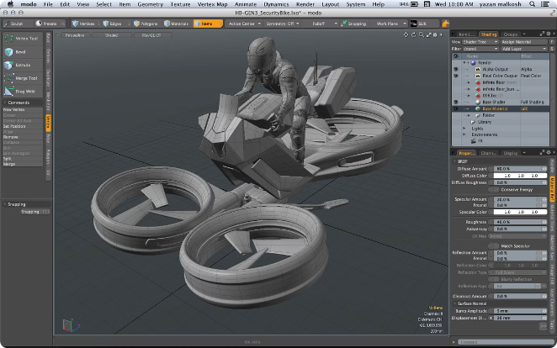
Computer Graphics Fundamentals
Understanding the fundamentals of computer graphics is crucial for building a visually compelling simulation. The core concepts of 3D modeling, animation, and rendering are essential.
1
3D Modeling
The process of creating the ship, its environment, and other objects in a three-dimensional space.
2
Animation
The process of bringing the ship and its environment to life, simulating its movement and interactions with the environment.
3
Rendering
The process of creating the final images from the 3D models and animations, applying textures, lighting, and special effects.

Slide 7

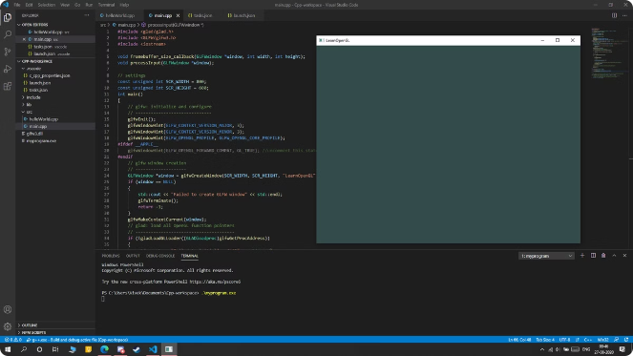
OpenGL Basics
OpenGL, a cross-platform graphics API, is commonly used for developing graphics-intensive applications. This project will leverage OpenGL for rendering the ship and its environment.
Vertex Shaders
Shaders responsible for manipulating the positions of vertices, affecting the shape and size of objects.
Fragment Shaders
Shaders responsible for determining the color and other properties of each pixel in the rendered scene.
Textures
Images applied to surfaces of 3D objects, adding realism and detail to the scene.
Lighting and Shadows
Techniques to simulate the interaction of light with objects, creating realistic visual effects.

Slide 8

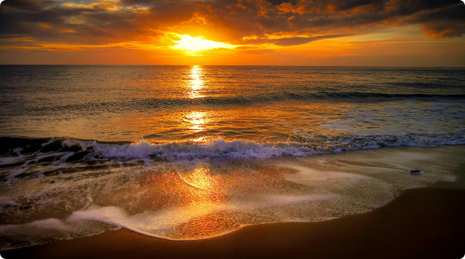



Dynamics Environment and Day-Night Cycle
Creating a dynamic environment is crucial for a convincing ship simulation. This includes simulating realistic weather effects and implementing a day-night cycle.
Weather Simulation
Includes wind, rain, waves, and other effects that dynamically affect the ship's movement and appearance.
Day-Night Cycle
Simulates the changing position of the sun and moon, affecting the lighting and appearance of the scene.
Celestial Bodies
Realistic depiction of the sun, moon, and stars, creating a more immersive and visually appealing experience.

Slide 9

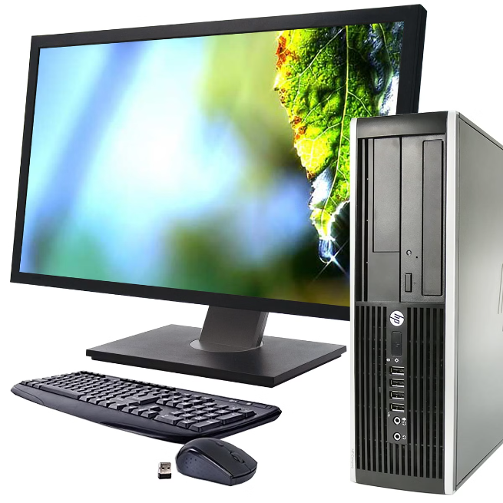
System Requirements Specifications
This section outlines the minimum hardware and software requirements necessary for the simulation to run smoothly and deliver the desired performance.
Operating System
Windows 10/11, macOS 10.15+, Linux (Ubuntu/Debian)
Processor
Intel Core i5 or AMD Ryzen 5 equivalent
Memory
8GB RAM
Graphics Card
NVIDIA GeForce GTX 1060 or AMD Radeon RX 580 equivalent
Storage
100GB available disk space

Slide 10

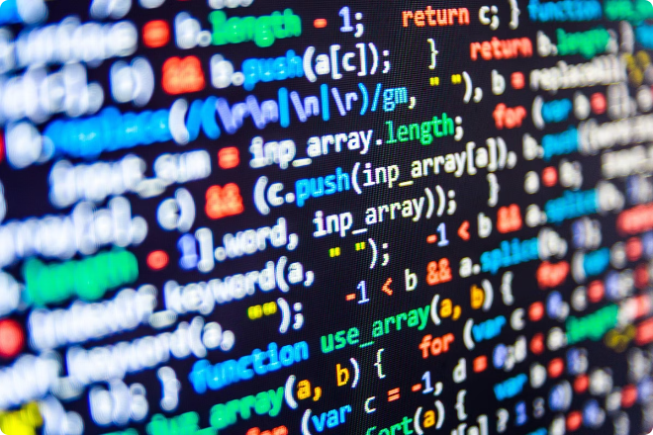
Software Requirements
The software components necessary for building the simulation, including development tools, libraries, and specific software packages.
1
3D Modeling Software
Software like Blender, Maya, or 3ds Max for creating the 3D models of the ship and environment.
2
Game Engine
A game engine like Unity or Unreal Engine for managing the simulation's logic, physics, and rendering.
3
OpenGL Libraries
The OpenGL libraries are essential for handling graphics rendering and creating visual effects.
4
Programming Language
A programming language like C++, C#, or Python for developing the simulation's code and logic.

Slide 11


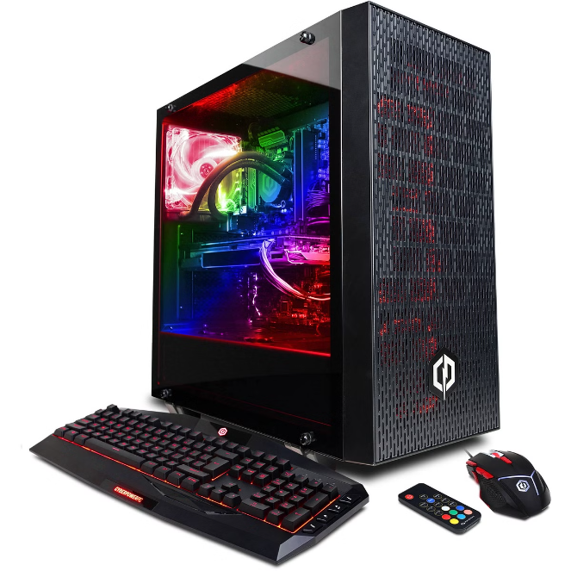



Hardware Requirements
This section outlines the hardware specifications needed to ensure smooth performance and a high-quality visual experience for the simulation.
Processor
A powerful processor capable of handling the complex calculations involved in rendering the simulation.
Memory
Sufficient RAM to store the game's data and assets, ensuring smooth performance without lag or stuttering.
Graphics Card
A high-performance graphics card to handle the demanding rendering tasks and provide a visually impressive experience.
Storage
Ample disk space to store the simulation's files, including the game engine, assets, and textures.

Slide 12

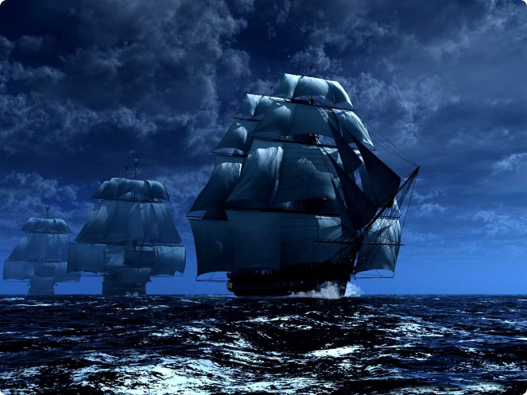
Conclusion and Key Takeaways
This presentation has outlined the key aspects of developing a realistic ship sailing simulation, covering the fundamental concepts, technical requirements, and desired outcomes.
1
Realistic Visuals
The simulation should strive for realistic visuals, capturing the beauty and details of a ship sailing at sea.
2
Dynamic Environment
A dynamic environment with weather effects and a day-night cycle adds realism and enhances the user's experience.
3
Immersive Experience
The goal is to create an immersive experience, allowing users to feel like they are on the ship, experiencing the journey.
4
Technical Expertise
This project demands a strong understanding of computer graphics, 3D modeling, animation, and game development principles.

